Slide 1
Week 2
Introduction to neural networks
and deep learning

Slide 2
Topics you have covered in week 2 videos
Feed forward
Back propagation
Fully connected layer - forward pass
Fully connected layer - backward pass
Activation functions
Activation functions in practice
Softmax
Cross entropy loss

Slide 3
Session agenda
Building blocks of neural network
Case study
Questions

Slide 4
Feed forward

Slide 5
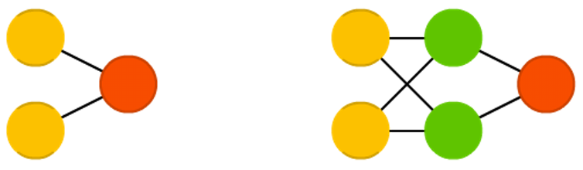
Feed forward neural network
Feed forward neural networks (FF or FFNN) and perceptrons (P) are very straight forward, they feed information from the front to the back (input and output, respectively). Neural networks are often described as having layers, where each layer consists of either input, hidden or output cells in parallel. A layer alone never has connections and in general two adjacent layers are fully connected (every neuron form one layer to every neuron to another layer). The simplest somewhat practical network has two input cells and one output cell, which can be used to model logic gates.
Image and text source: asimovinstitute

Slide 6
Feed forward network characteristics
Perceptrons are arranged in layers, with the first layer taking in inputs and the last layer producing outputs. The middle layers have no connection with the external world, and hence are called hidden layers.
Each perceptron in one layer is connected to every perceptron on the next layer. Hence information is constantly "fed forward" from one layer to the next., and this explains why these networks are called feed-forward networks.
There is no connection among perceptrons in the same layer.
Text source: cs.stanford.edu

Slide 7
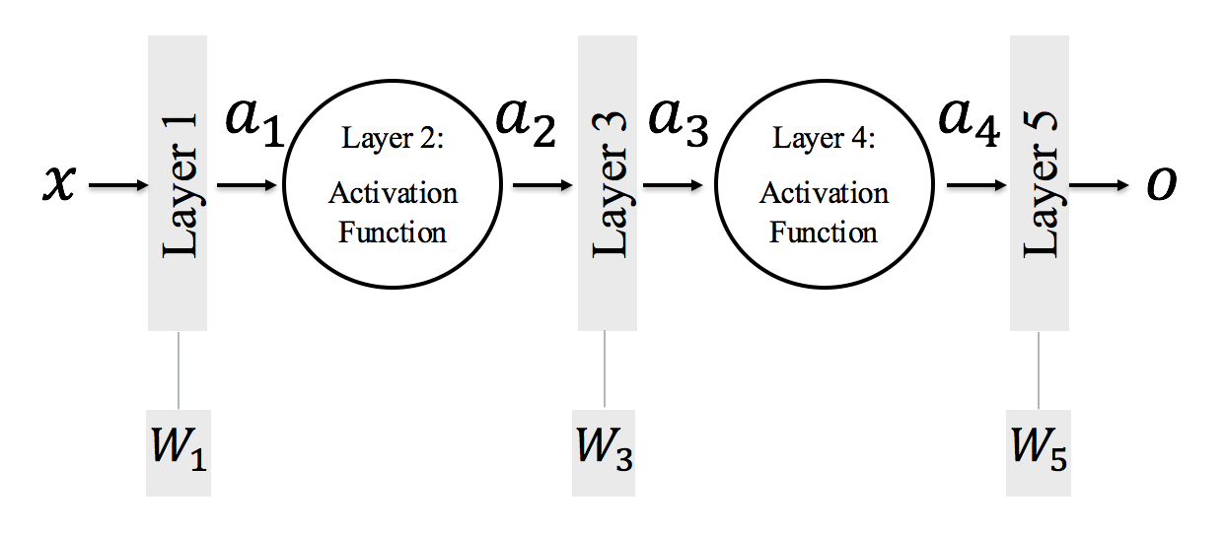
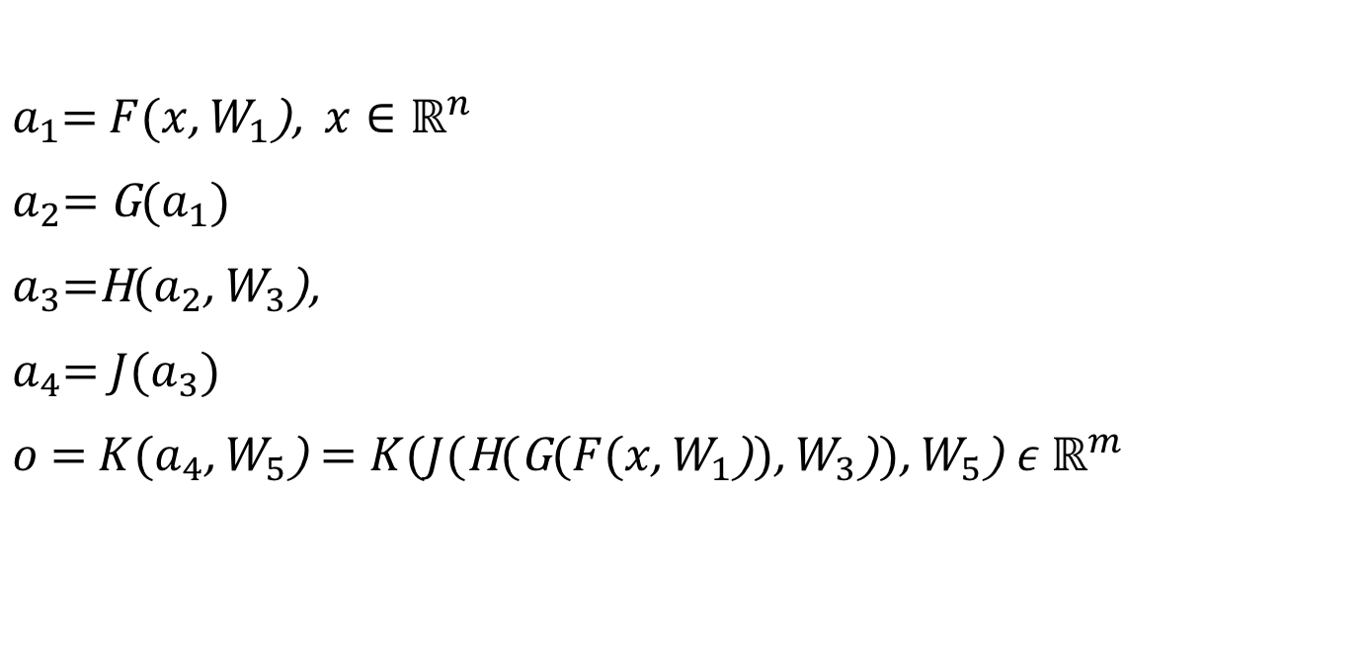
Feed forward - composition of functions

Slide 8
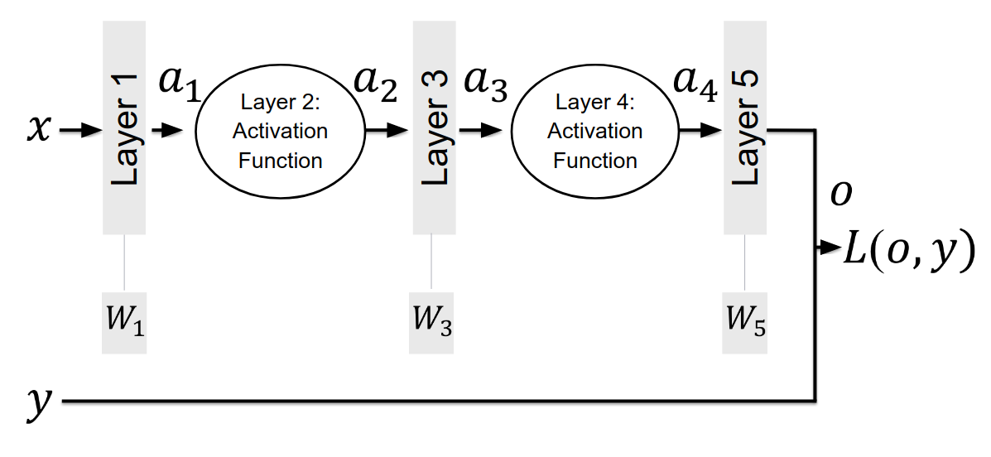
Feed forward - loss

Slide 9
Backward propagation

Slide 10

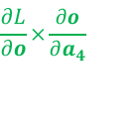

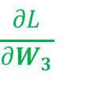


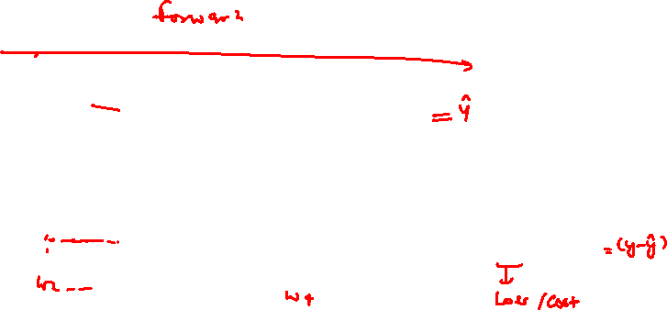
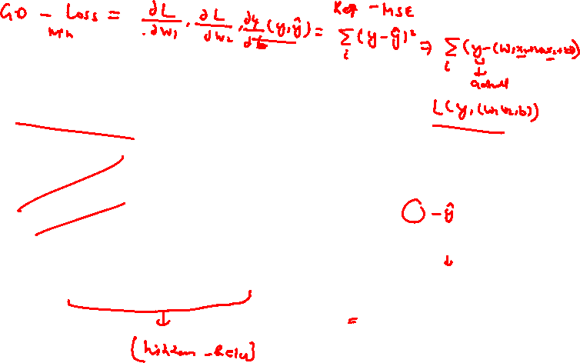
Backprop

Slide 11
Backprop

Slide 12
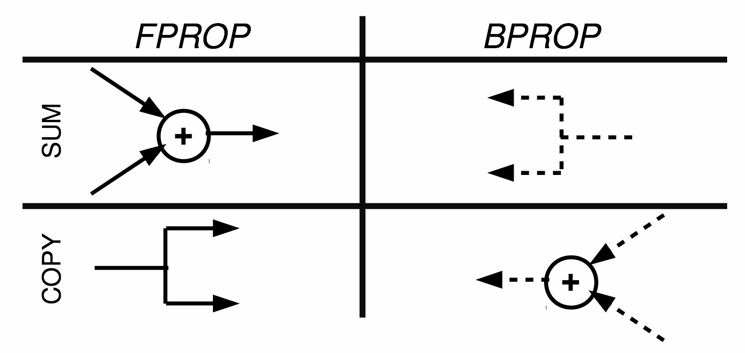
Forward prop and backward prop are duals

Slide 13
Activation functions

Slide 14
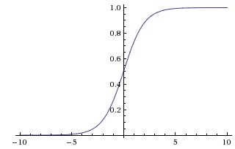
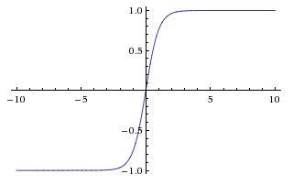
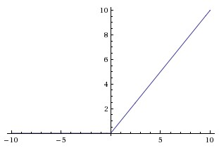
Types of activation function
Sigmoid
Tanh
ReLU
Every activation function (or non-linearity) takes a single number and performs certain fixed mathematical operation on it.
Images and text source: cs231n stanford

Slide 15
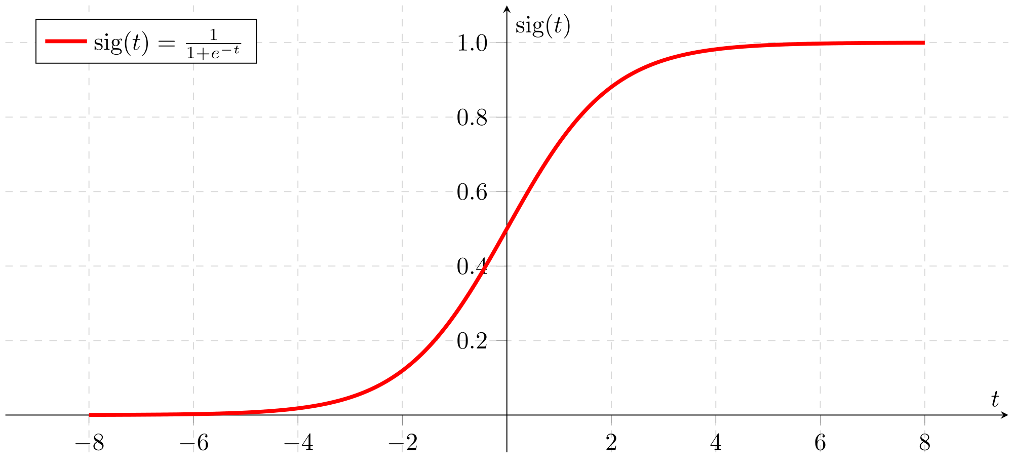
Sigmoid function
Activation function of form f(x) = 1 / 1 + exp(-x)
Ranges from 0-1
S-shaped curve
Historically popular
Interpretation as a saturating “firing rate” of a neuron
Drawbacks
Its output is not zero centered. Hence, make the gradient go too far in different directions
Vanishing Gradient Problem
Slow convergence
Image source: wikimedia

Slide 16
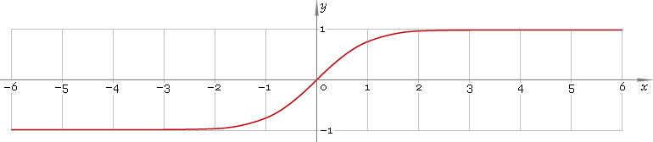
Tanh function
Drawbacks
Though optimisation is easier, it still suffers from the Vanishing Gradient Problem
Ranges between -1 to +1
Output is zero centered
Generally preferred over Sigmoid function
Image source: librow

Slide 17
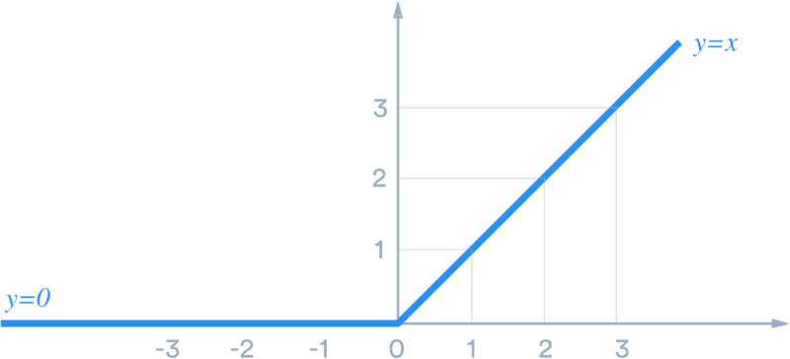
ReLU function
Very simple and efficient
Have 6x times better convergence than tanh and sigmoid function.
Very efficient in computation
Drawbacks
Output is not zero centered.
Should only be used within hidden layers of a NN model
Image source: medium

Slide 18
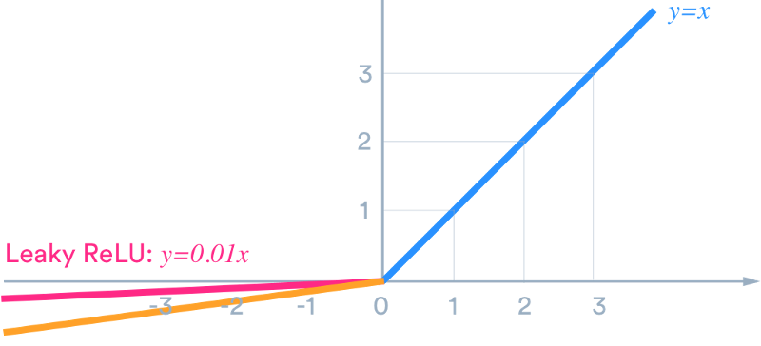
Leaky ReLU function
Leaky ReLU was introduced to overcome the problem of dying neurons.
Leaky ReLU introduces a small slope to keep the neurons alive
Does not saturate (in +region)
Image source: medium

Slide 19
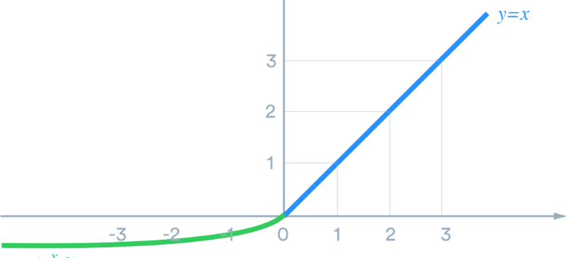
ELU function
ELU function tend to converge cost to zero faster and produce more accurate results
Closer to zero mean outputs
Has a extra alpha constant which should be positive number
ELU is very similar to RELU except negative inputs
Have all advantages of ReLU
Drawbacks
Computation requires exp()
Image source: medium

Slide 20
Fully-connected layer

Slide 21
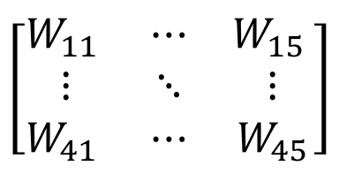



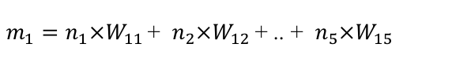
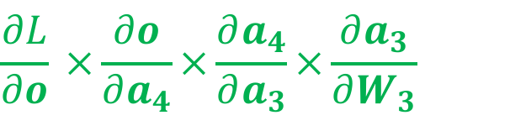



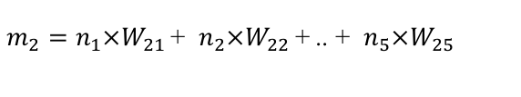


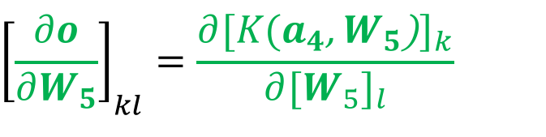
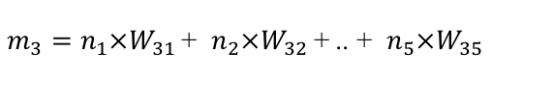
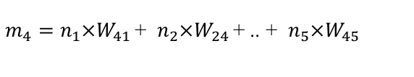
Fully connected layer

Slide 22
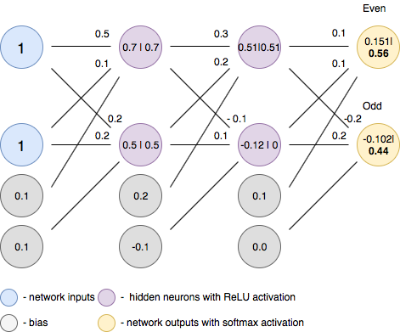
FC layer - forward pass
Forward pass is basically a set of operations which transform network input into the output space. During the inference stage neural network relies solely on the forward pass.
Images and text source: towardsdatascience

Slide 23
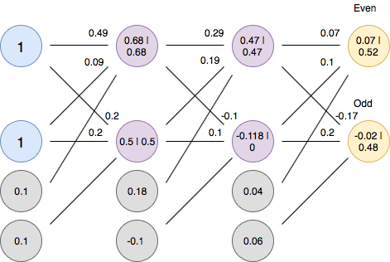
FC layer - backward pass
Backpropagation is an algorithm which calculates error gradients with respect to each network variable (neuron weights and biases). Those gradients are later used in optimization algorithms, such as Gradient Descent, which updates them correspondingly. The process of weights and biases update is called Backward Pass.
Images and text source: towardsdatascience

Slide 24
Softmax function

Slide 25
Softmax
Softmax function is a multinomial logistic classifier, i.e. it can handle multiple classes
Softmax typically the last layer of a neural network based classifier
Softmax function is itself an activation function, so doesn’t need to be combined with an activation function

Slide 26
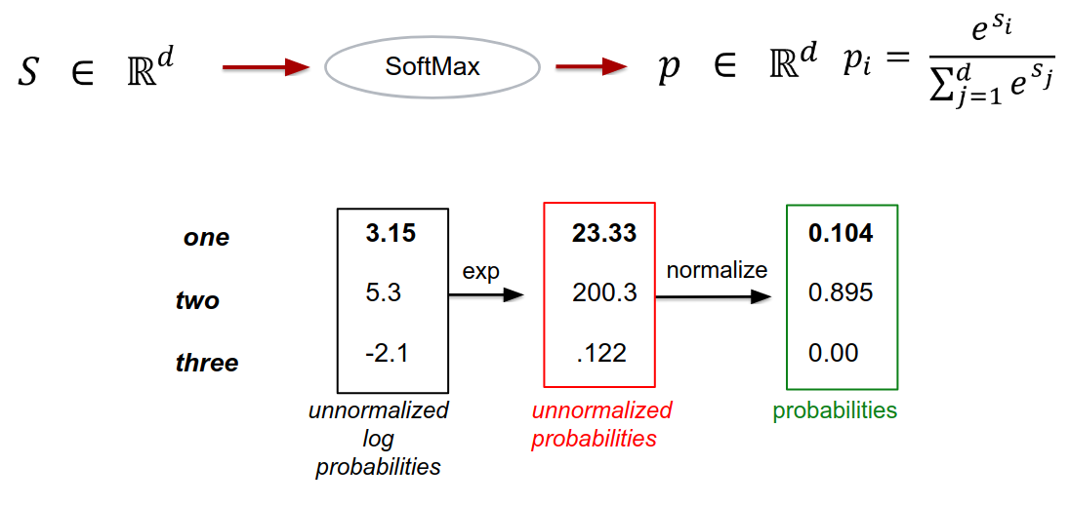
Softmax

Slide 27
Cross-entropy loss

Slide 28
Cross-entropy loss
Cross-entropy loss (often called Log loss) quantifies our unhappiness for the predicted output based on its deviation from the desired output
Perfect prediction would have a loss of 0
With gradient descent, we try to reduce this (cross-entropy) loss for a classification problem

Slide 29
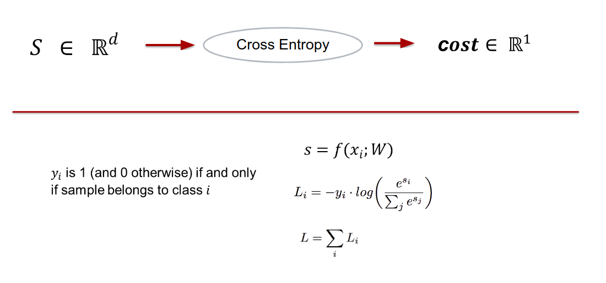
Cross-entropy loss

Slide 30
Summary

Slide 31
In summary - building blocks of deep NNs
Forward Propagation
Backward Propagation
Activation Layers (ReLU, Sigmoid, tanh…)
Fully Connected Layer
Convolution Layer
Max Pooling Layer
… and so on

Slide 32


Slide 33
Thank you! :)
Questions are always welcome

